Slide 1
Tutorial 2: A Tutorial on the Image Rectification in MIKE
Author: Md. Nazmus Sanib Chowdhury
Scientific Officer
Hydrography & Oceanography
Celestial Tech Limited

Slide 2
Overview
Image rectification is a transformation process used to project images onto a common image plane.
Suppose that, we have a image of an admiralty chart and we know the coordinate of each vertex of this chart.
To let the MIKE software to know the coordinate of the vertices of this image we will undergo a process used by the tools “Image Rectifier” which is a MIKE module.

Slide 3
At first, have a look on the original image of admiralty chart in the following:

Slide 4
In the Admiralty chart, the label and ruler of the longitude are labeled across the uppermost and lowermost portion of the map.
And the label and ruler of the latitude are labeled across the rightmost and leftmost portion of the map.

Slide 5
We will now mark the vertices of area of interest (for simulation and which will define as the simulation area) from the admiralty chart.
Open the admiralty chart with paint software.

Slide 6
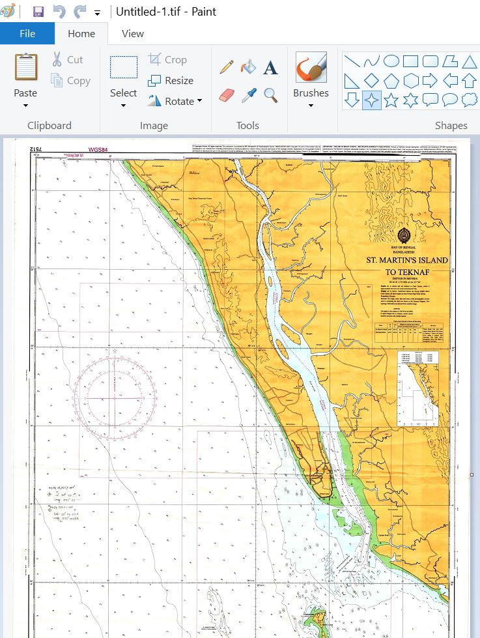

Slide 7
Draw a rectangle by interconnecting the lines as the following.
The vertical lines of the rectangle are extended to the ruler label of the longitude (the ruler label of the longitude is situated in the uppermost portion of the admiralty chart).
The horizontal lines of the rectangle are extended to the ruler of the latitude(the ruler label of the latitude is situated in the uppermost portion of the admiralty chart).

Slide 8
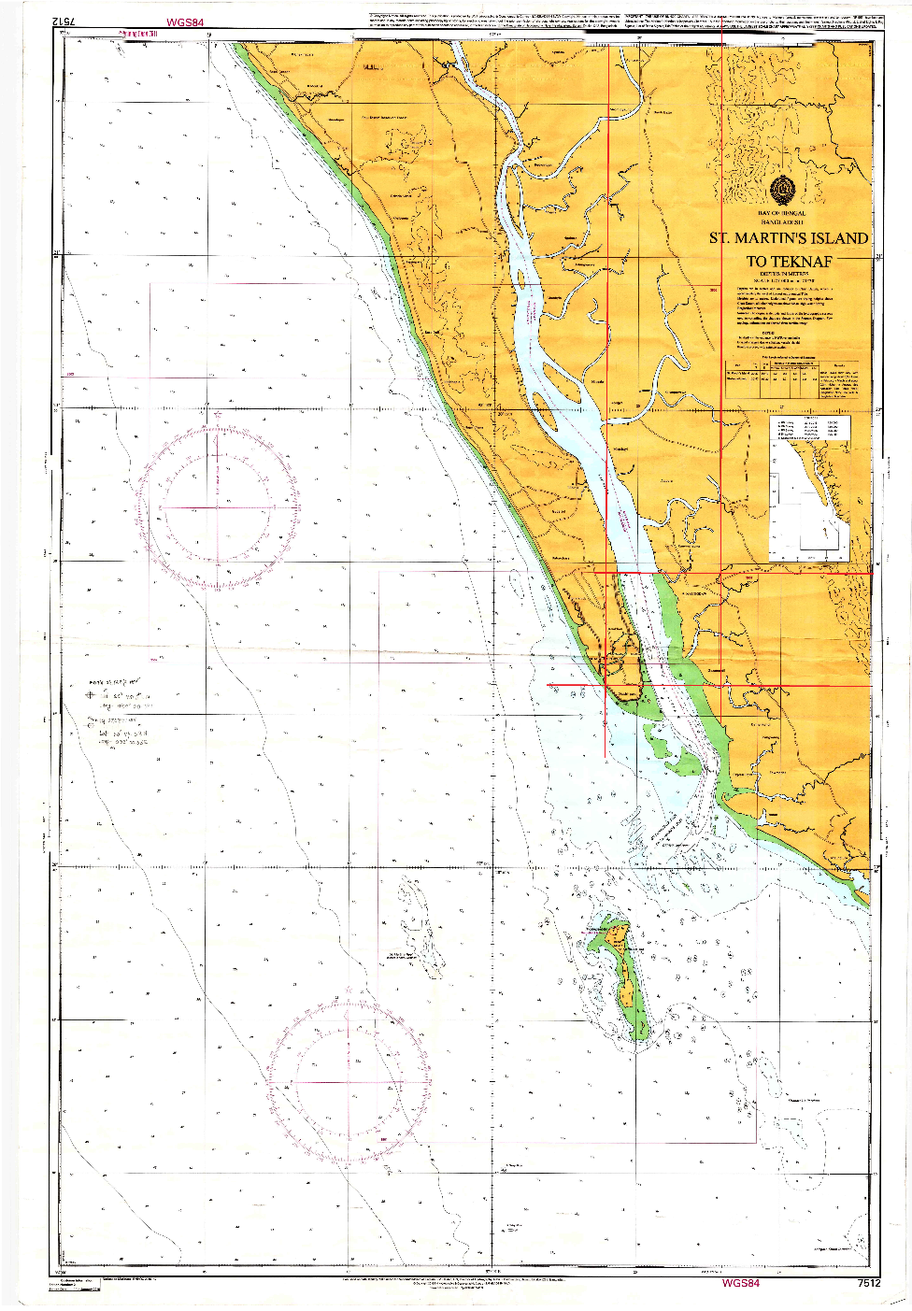
Rectangle

Slide 9
Now observe the intersection between the lines and ruler label in the uppermost portion and leftmost portion of the map.
Measure the latitude and longitude by observing that the intersection points are intersected at which position of the ruler.

Slide 10
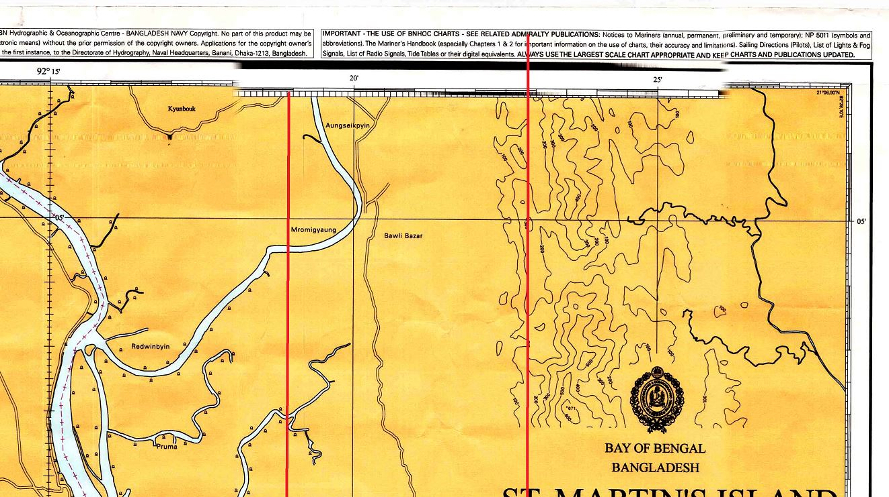
Intersection with the longitude ruler

Slide 11
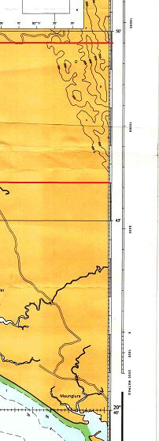
Intersection with latitude ruler

Slide 12
In our case, the measured longitudes are 92°19´54´´ and 92°22´48.6´´.
The latitudes are 20°49´42´´ and 20°46´.
Thus the 4 vertices of the rectangle are as the following:
Table 1
Vertex | Longitude | Latitude
Lower-left | 92°19´54´´ | 20°46´
Lower-right | 92°22´48.6´´ | 20°46´
Upper-right | 92°22´48.6´´ | 20°49´42´´
Upper-left | 92°19´54´´ | 20°49´42´´

Slide 13
In the following slide, the names of the anchors/vertices are showed

Slide 14

Image 1
Upper-left
Upper-right
Middle-left
Middle-right
Lower-left
Lower-right

Slide 15
Also calculate the geographic location of the middle point of the right arm and left arm of the rectangle.
Table 2
Vertex | Longitude | Latitude
Lower-left | 92°19´54´´ | 20°46´
Lower-right | 92°22´48.6´´ | 20°46´
Middle-right | 92°22´48.6´´ | 20°47´51´´
Upper-right | 92°22´48.6´´ | 20°49´42´´
Upper-left | 92°19´54´´ | 20°49´42´´
Middle-left | 92°19´54´´ | 20°47´51´´

Slide 16
Table 3
Vertex | Longitude | Latitude | Easting | Northing
Lower-left | 92°19´54´´ | 20°46´ | ? | ?
Lower-right | 92°22´48.6´´ | 20°46´ | ? | ?
Middle-right | 92°22´48.6´´ | 20°47´51´´ | ? | ?
Upper-right | 92°22´48.6´´ | 20°49´42´´ | ? | ?
Upper-left | 92°19´54´´ | 20°49´42´´ | ? | ?
Middle-left | 92°19´54´´ | 20°47´51´´ | ? | ?

Slide 17
Calculate the Easting and Northing from Longitude and Latitude respectively
We can calculate the Easting and northing from Longitude and Latitude by using online calculator. Search in google: “online latitude, longitude to UTM converter”.
Or, alternatively we could use built-in calculator provided by the mike zero to convert latitude, longitude to northing and easting.
Open the Mike Zero.

Slide 18
Calculate the Easting and Northing from Longitude and Latitude respectively
From the menu option of the Mike Zero window, Navigate to the following:
File>New>File

Slide 19
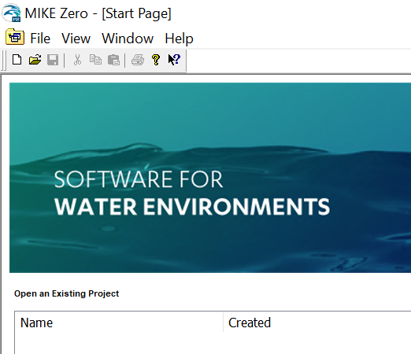

Slide 20
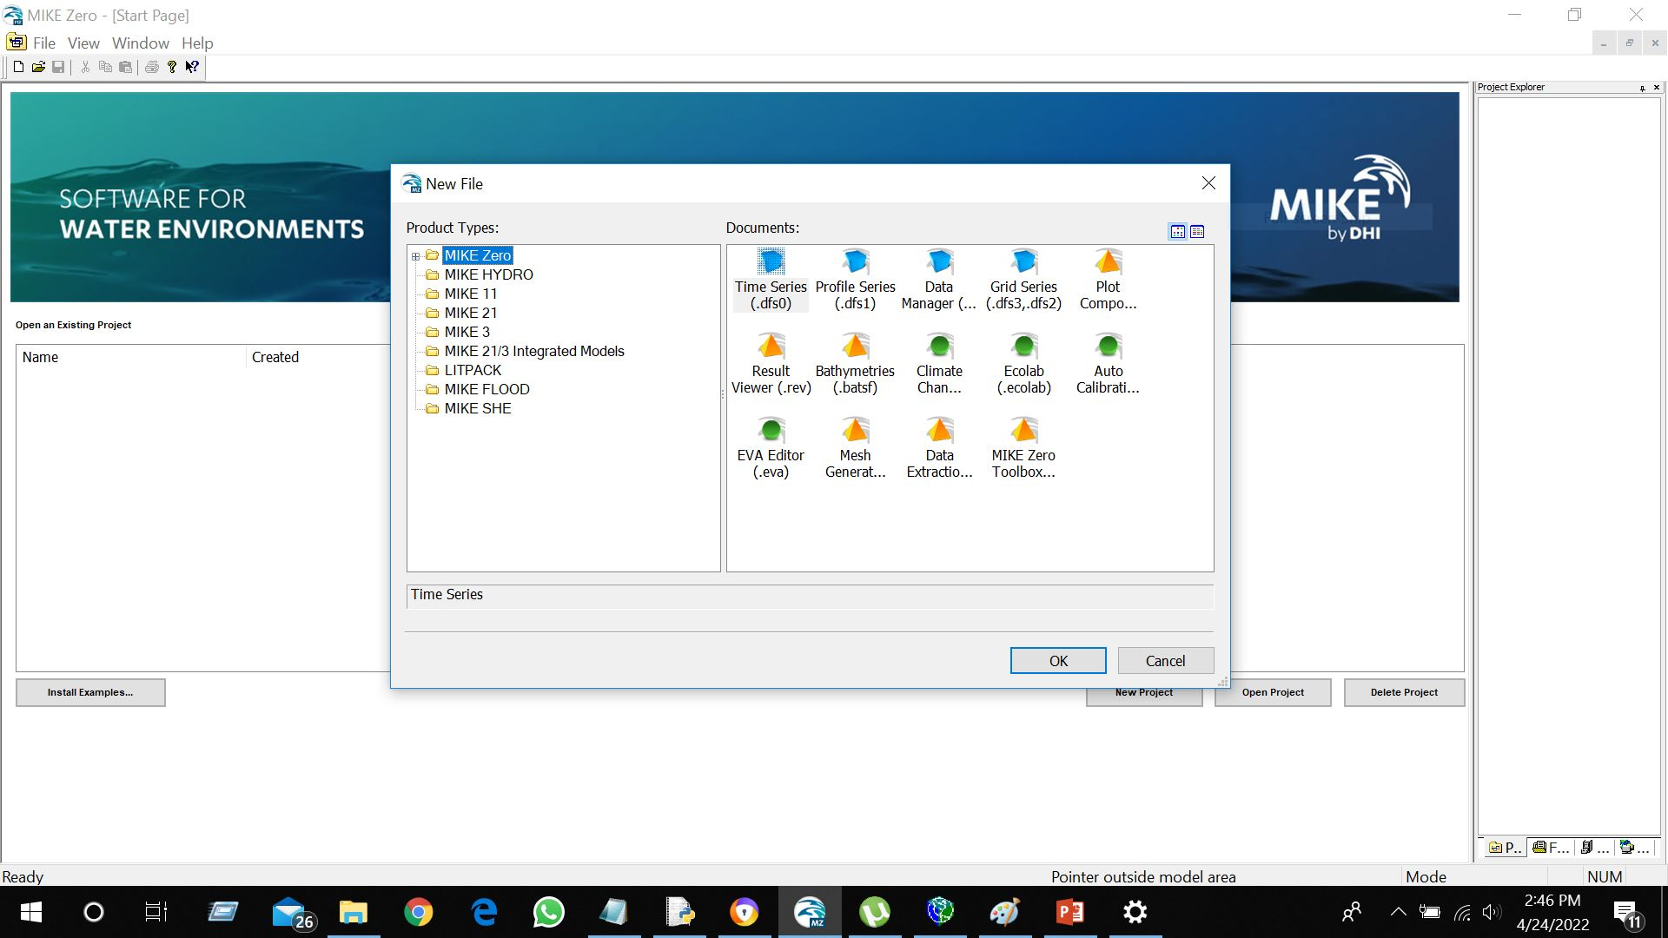
The “New File” dialog box will be open

Slide 21
From the “New File” dialog box, navigate to the following:
Mike Zero > Bathymetries(.batsf) > OK

Slide 22
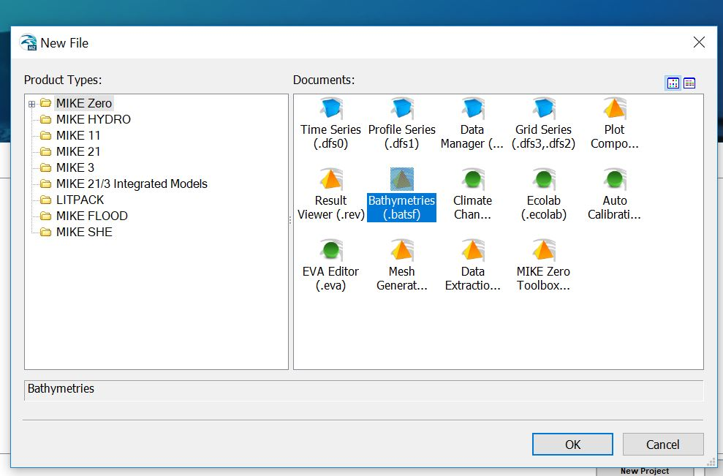
1
2
3

Slide 23
Then “Define Working Area” dialog box will be opened.

Slide 24
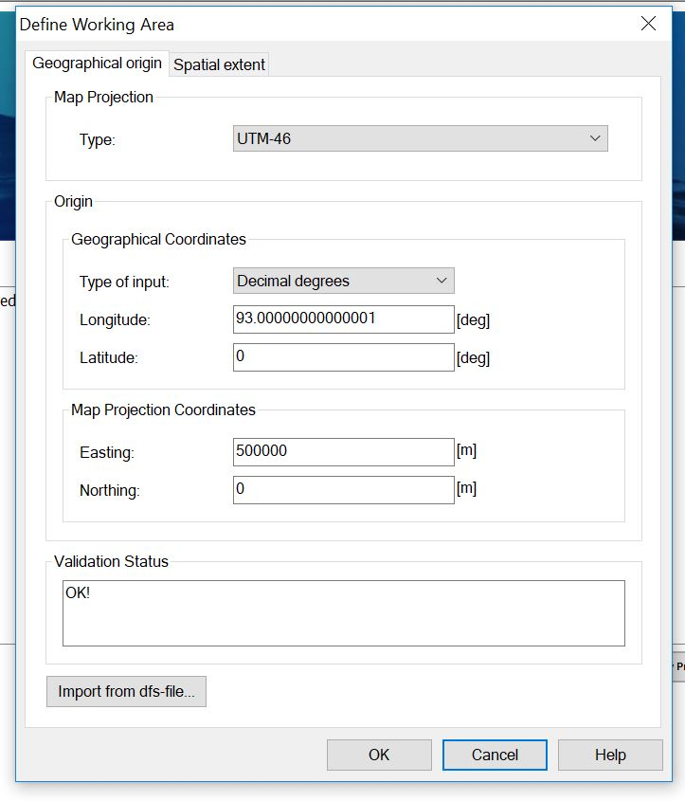

Slide 25
In the “Define Working Area”, right to “Type:” select “UTM-46” from the drop-down list of options of projection system.
In the “Define Working Area”, right to “Type of input:” select “Degrees, minutes, seconds” from the drop-down list of options.

Slide 26
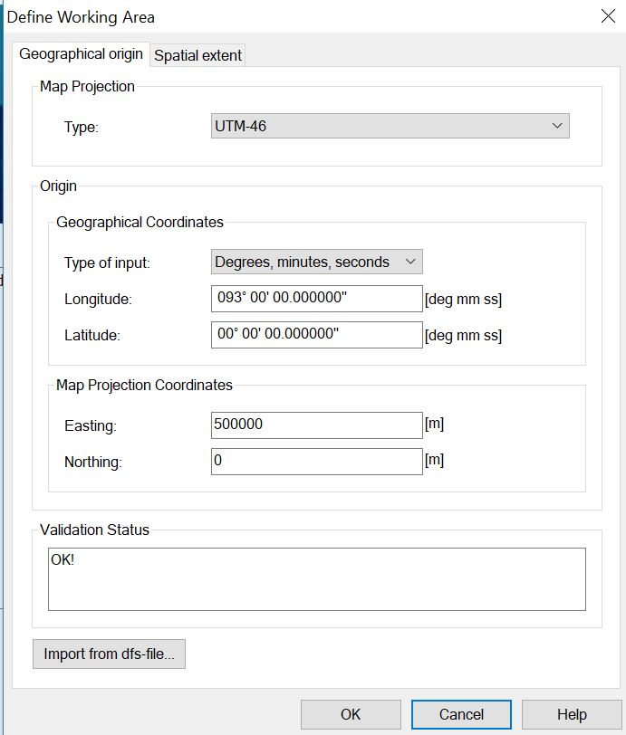

Slide 27
Take the values of Longitude and Latitude from a row of the Table 2,
Feel these input into the left of the “Longitude:” and “Latitude:” field of the “Define Working Area” dialog box.
Then copy the values of the Easting and Northing from the right of the “Easting:” and “Northing:” field of the “Define Working Area” dialog box.
Past the value of the copied Easting and Northing in the corresponded column of the Table 3.
Do this for every columns of the Table 2 and Table 3.

Slide 28
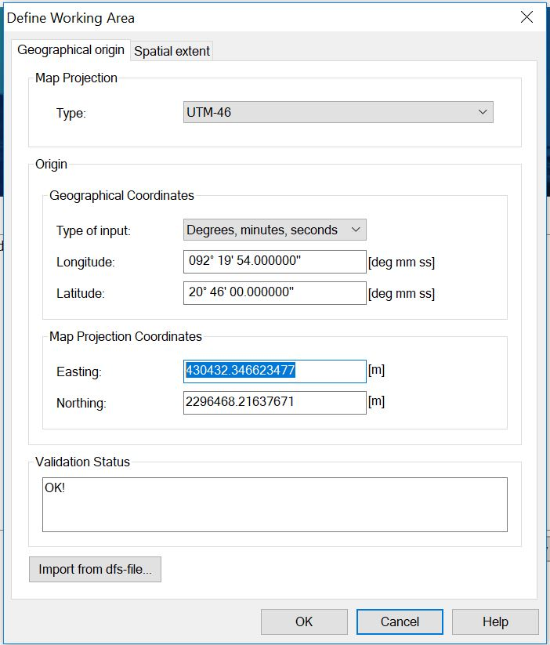

Slide 29
Calculated Easting and Northing
Table 4
Vertex | Longitude | Latitude | Easting | Northing
Lower-left | 92°19´54´´ | 20°46´ | 430432.346623477 | 2296468.21637671
Lower-right | 92°22´48.6´´ | 20°46´ | 435507.143336972 | 2296448.09300458
Middle-right | 92°22´48.6´´ | 20°47´51´´ | 435494.025654783 | 2299860.56603041
Upper-right | 92°22´48.6´´ | 20°49´42´´ | 435480.926591805 | 2303273.05116488
Upper-left | 92°19´54´´ | 20°49´42´´ | 430432.346623477 | 2303293.22344041
Middle-left | 92°19´54´´ | 20°47´51´´ | 430446.470838995 | 2299880.71386586

Slide 30
Find out the easting and northing of origin
From Table 4, lowest longitude value = 92°19´54´´ and the lowest latitude value = 20°46´
We will use the origin as (92°18´54´´ ,20°45´).
Again, to calculate easting and northing of this coordinate, we would use the “Define Working Area” dialog box. Input the longitude and latitude value as #
The calculated
(Easting, Northing) = (428689.614308852, 2294630.88853734)

Slide 31
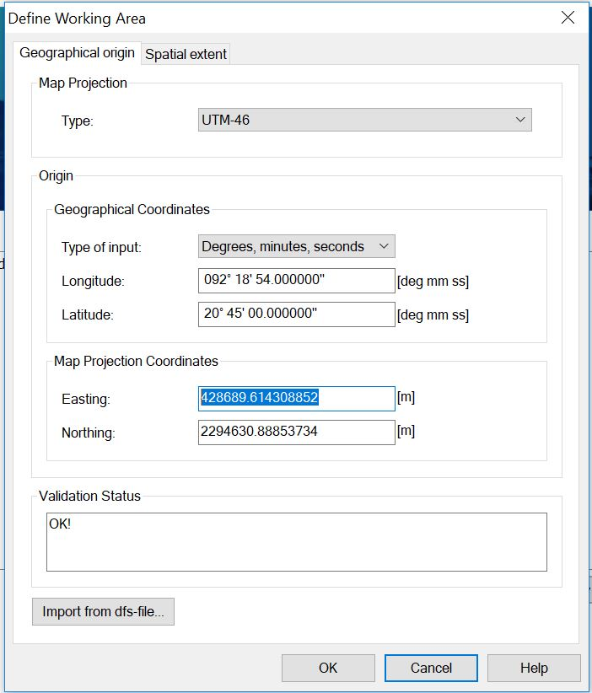

Slide 32
Find out the width and height
x1 = easting of origin, x2 = converted_easting(using the coordinate of lower right vertex: longitude+1 minute, latitude-1 minute)
Width = x2-x1
y1 = northing of origin, y2 = converted_northing(using the coordinate of upper left vertex: longitude – 1 minute, latitude+1 minute)
Height = y2-y1
Again find out the x2(easting) and y2(northing) of the using the “Define Working Area” dialog box as a calculator.

Slide 33
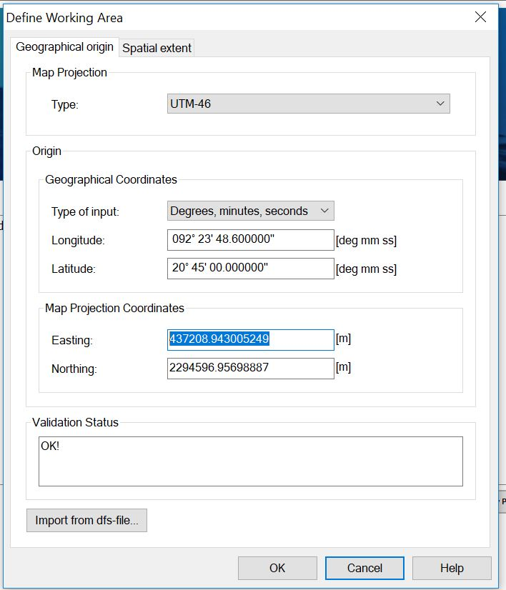
The Longitude of the lower right vertex + 1 minute
The Latitude of the lower right vertex
– 1 minute
x1
Northing has no use for width calculation

Slide 34
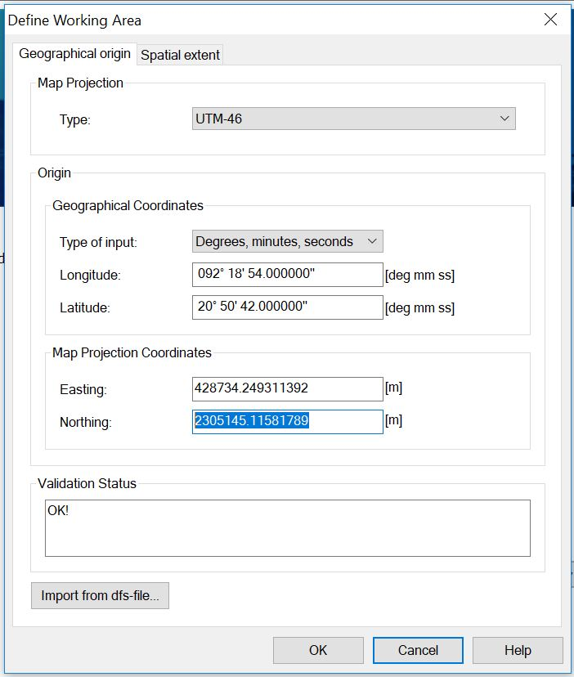
Longitude of upper left vertex -1 minute
Latitude of upper left vertex +1 minute
Easting has no use in the height calculation
y2

Slide 35
Find out the width and height
x1 = 428689.614308852, x2 = 437208.943005249
Width = x2 – x1 = 8520 (rounded value)
y1 = 2294630.88853734, y2 = 2305145.11581789
Height = y2 – y1 = 10515 (rounded)
Width = 8520
Height = 10515

Slide 36
Close the “Define Working Area” dialog box and MIKE ZERO.

Slide 37
Crop the image # beyond the boundary of rectangle
Open the image# with photos (i.e., or with any other software by which image can be cropped) and crop it beyond the boundary of rectangle.
Save a copy after cropping.

Slide 38
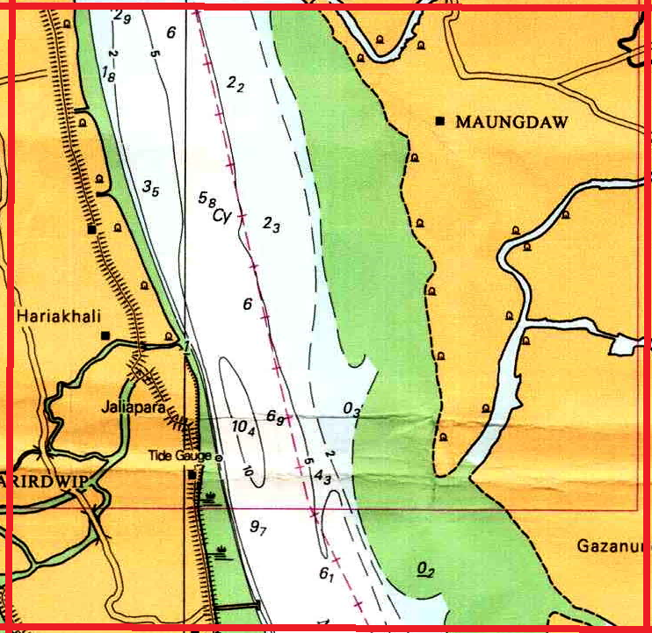
Cropped Image

Slide 39
Draw line across the middle of the cropped image
Open the cropped image with Paint software. Or any other software by which you can draw straight line on the image.
Draw a line across the middle of the image (in a straightforward way, you can determine the mid point by using a transparent ruler, set the ruler on the parallel to your computer’s monitor to determine the mid point) and save a copy of this image.

Slide 40
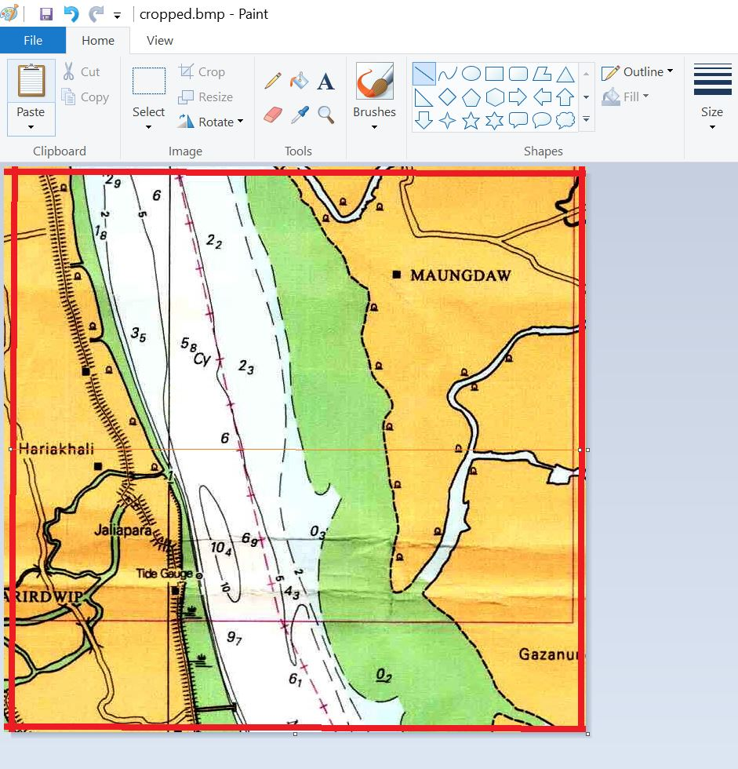
Draw Line with paint software

Slide 41
2. Open Image Rectifier
We are assuming that you are using MIKE 2014 version in windows 10.
Open start button.
Go to the folder MIKE by DHI 2014.
Open Image Rectifier by clicking on the icon of the Image Rectifier.
Alternatively you can open the Image Rectifier by searching the ‘Image Rectifier” in the search-box of the windows which is located right to the windows symbol. Click on the icon of the Image Rectifier in order to open it.

Slide 42
2.
Navigate to the File> New > Open the image created in step #

Slide 43
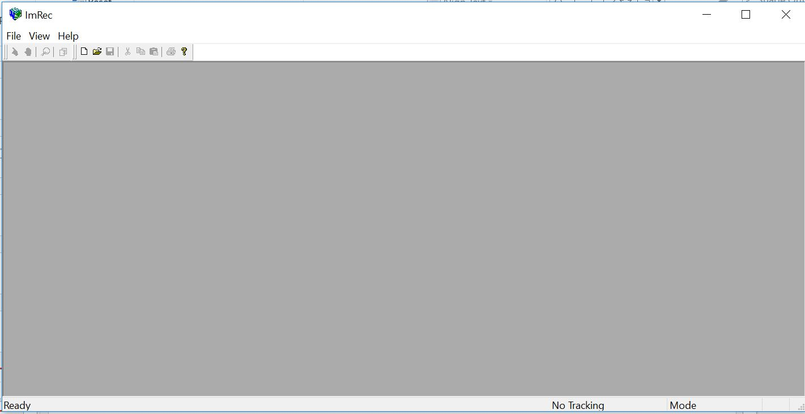
File > New

Slide 44
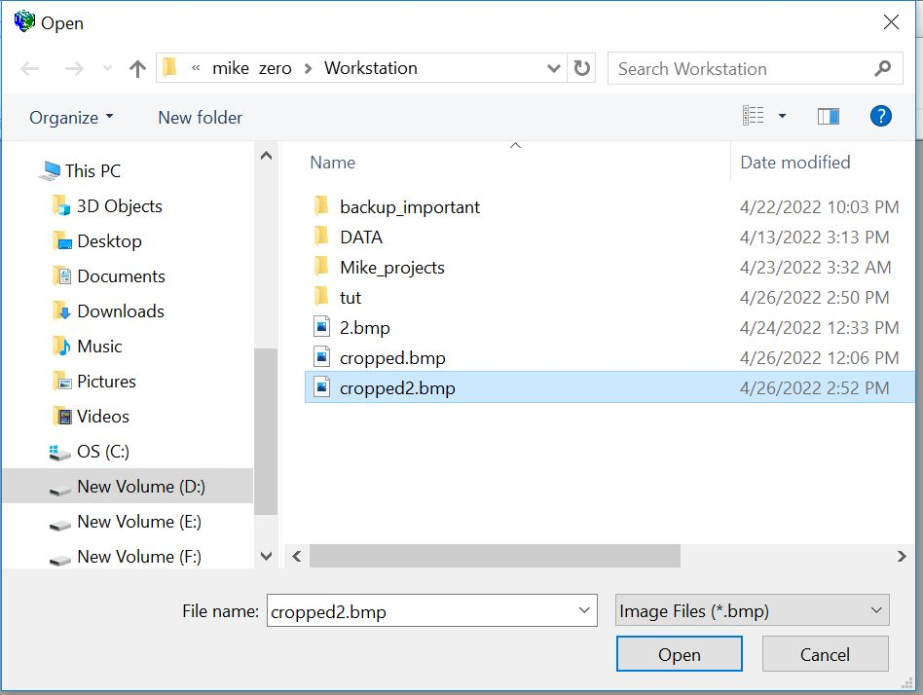
Open the image file created in step #

Slide 45
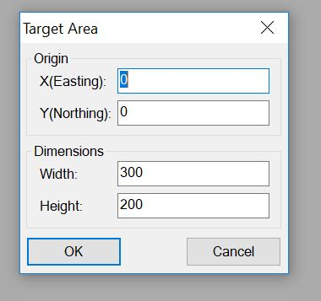
Then a “Target Area” dialog box will be opened

Slide 46
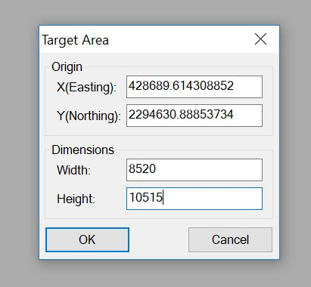
Input the information of Easting, Northing, Width and Height in the “Target Area” dialog box.

Slide 47
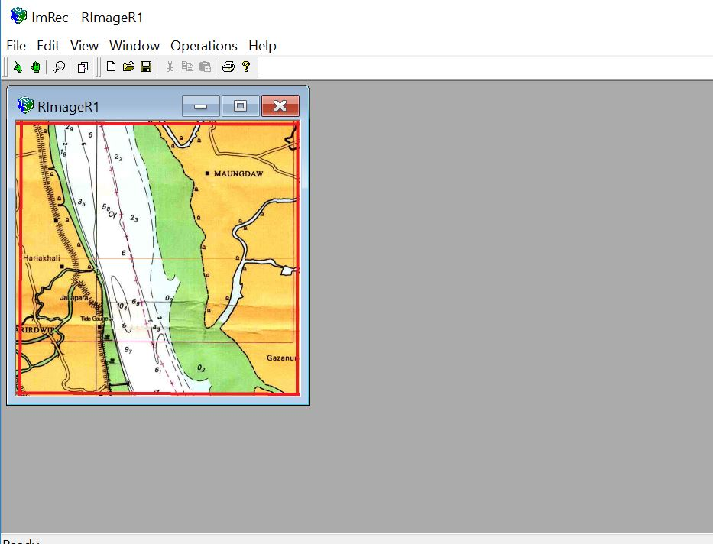
Than the cropped image will be opened in the windows of the Image Rectifier

Slide 48
Introducing different menu options of Image Rectifier
5
3
7
4
1
2
6

Slide 49
Introducing different menu options of Image Rectifier
Tool 1: Zoom In/out :: Zoom in on a point of image by click on the Zoom In/Out and than left click on the mouse. But, right click on the mouse for zoom out.
Tool 2: Add new GCP :: To create a Ground Control Point or GCP
Tool 3: Pick mode :: Select a GCP point after creating GCP
Tool 4: Move Points :: To set the GCP into the exact accurate position on the image

Slide 50
Introducing different menu options of Image Rectifier
Tool 5: Navigate to Operations > Rectification of 2nd. Order :: The final step of image rectification, if you have exactly 6 GCPs
Tool 6: Image window
Tool 7: Minimize/Maximize Image Window

Slide 51
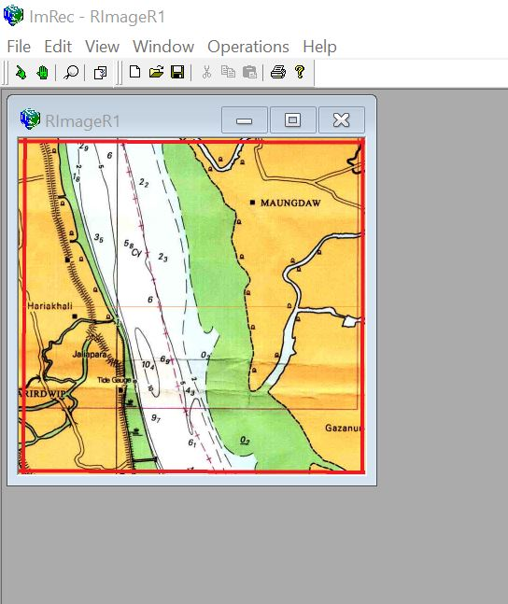
Maximize the Image Window by clicking on the Maximize tab indicated by the red mark in the following

Slide 52
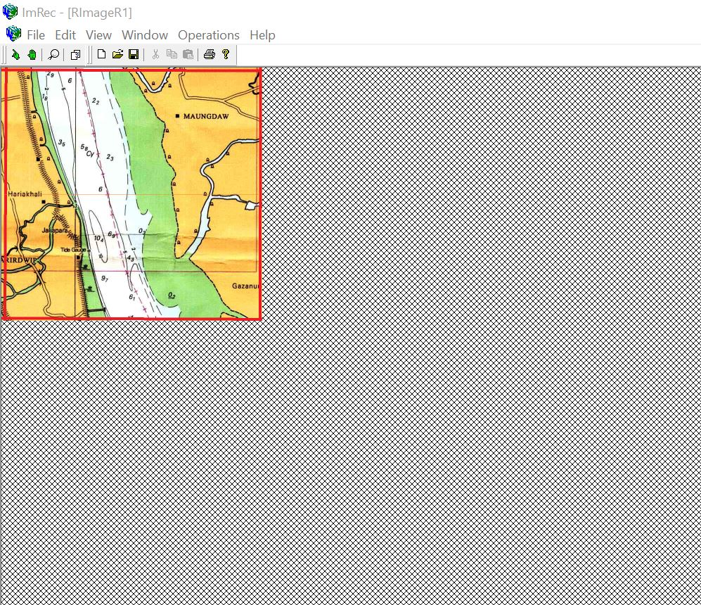
After Maximizing the Image Window

Slide 53
Now we will add 6 GCPs on the vertices of the image window. To do this we will use the values of easting and northing from the table 4, where the coordinate of each vertices were converted into easting and northing.

Slide 54
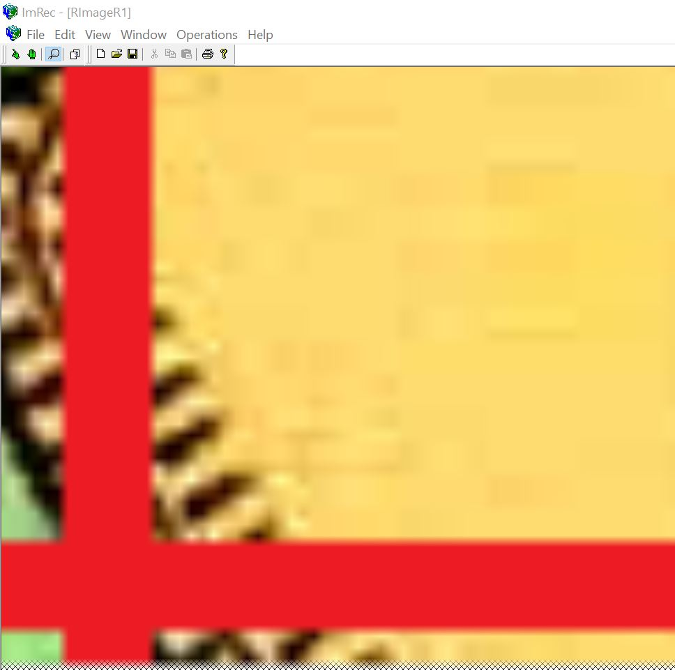
To select the point to add GCP precisely, first magnify the lower-left vertex using the tool 1. To do that, place the tool 1 on the lower left vertex. Left click for zoom in and right click for zoom out. And center of zoom in and zoom out will be the location where the tool 1 is placed on the image window. You should magnify the image enough as the following image to add the GCP in a precise location.

Slide 55
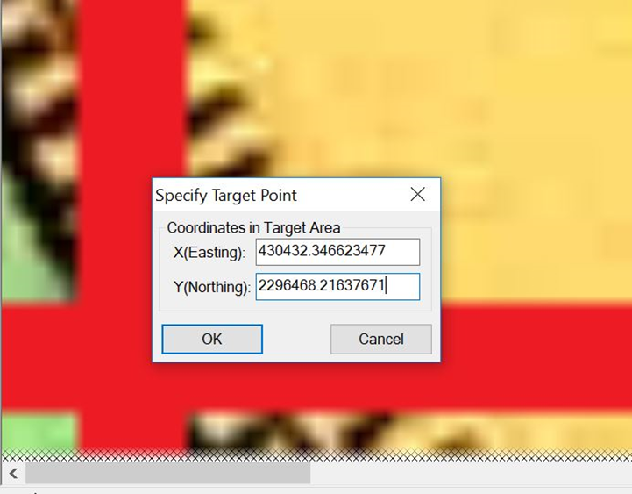
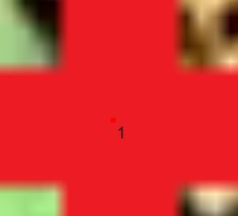
Use the tool 2 to add new GCP. First click on the tool 2 and then click on the point you want to add GCP. In our case we are clicking on the lower left vertex of the previously magnified image window. Than enter the Easting and northing. The values of easting and northing for the lower left vertex is available in the table 4.

Slide 56

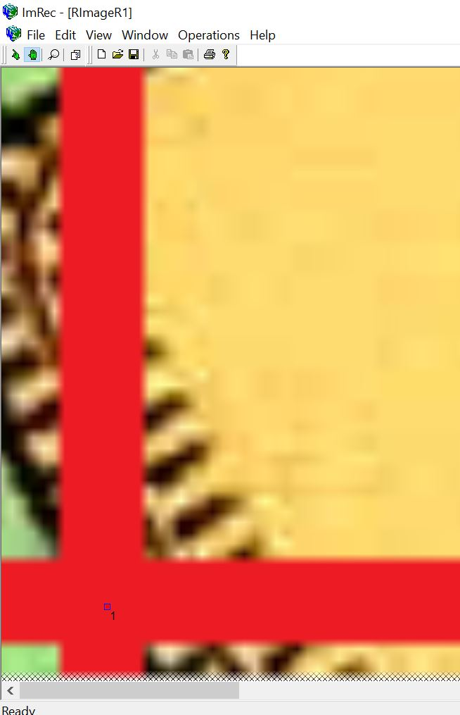
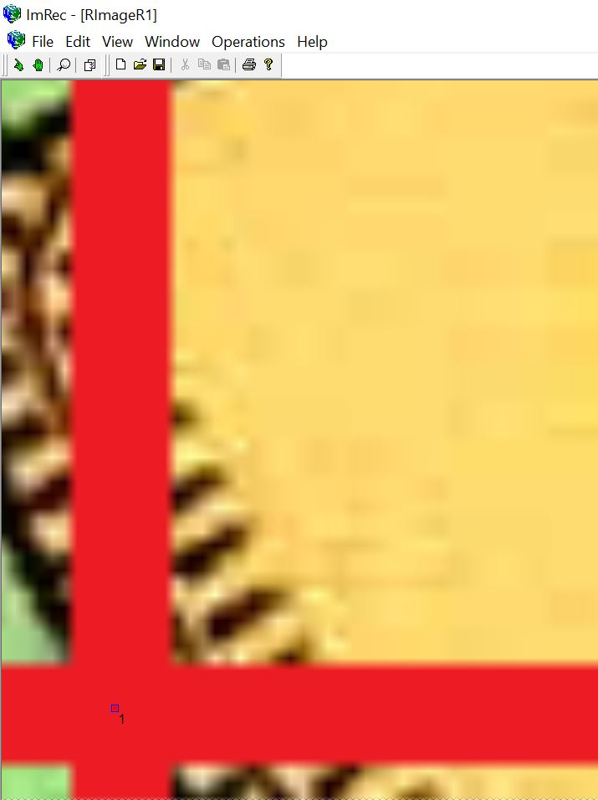
We have mistakenly set the GCP in slightly different position than the expected position. Hopefully we could reposition the GCP by using the tool 3 and tool 4. First click on the tool 3, select the just added GCP, then move the position of the GCP to the expected position by the tool 4.

Slide 57
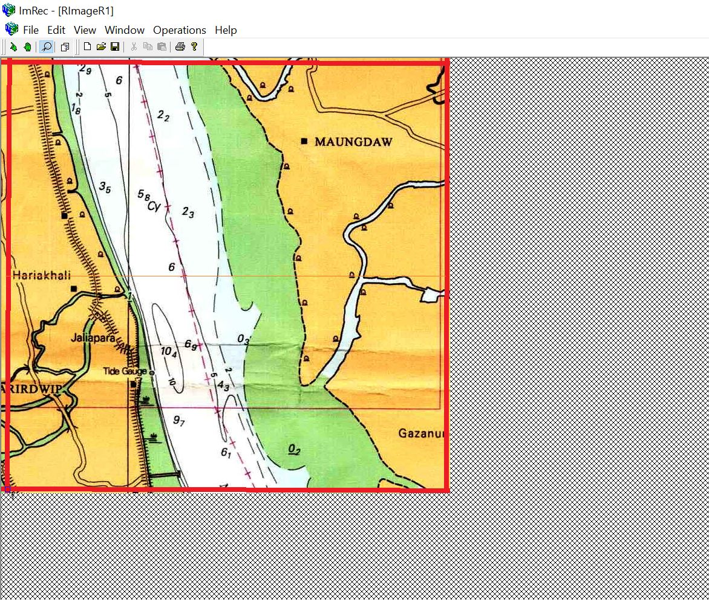
Return to the smaller window by zoom out. To zoom out use the tool 1. Click on the tool 1 and right click on a point of the image window. The center of zoom out would be the point on which the right clicking was done.

Slide 58
In the same way add GCP for all other vertices listed in table 4

Slide 59
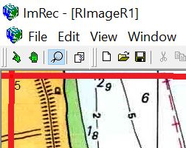
If any GCP need to be deleted, then select the GCP to be deleted by using tool3 and Navigate to the Edit> Delete from the menu button or use Delete hotkey

Slide 60
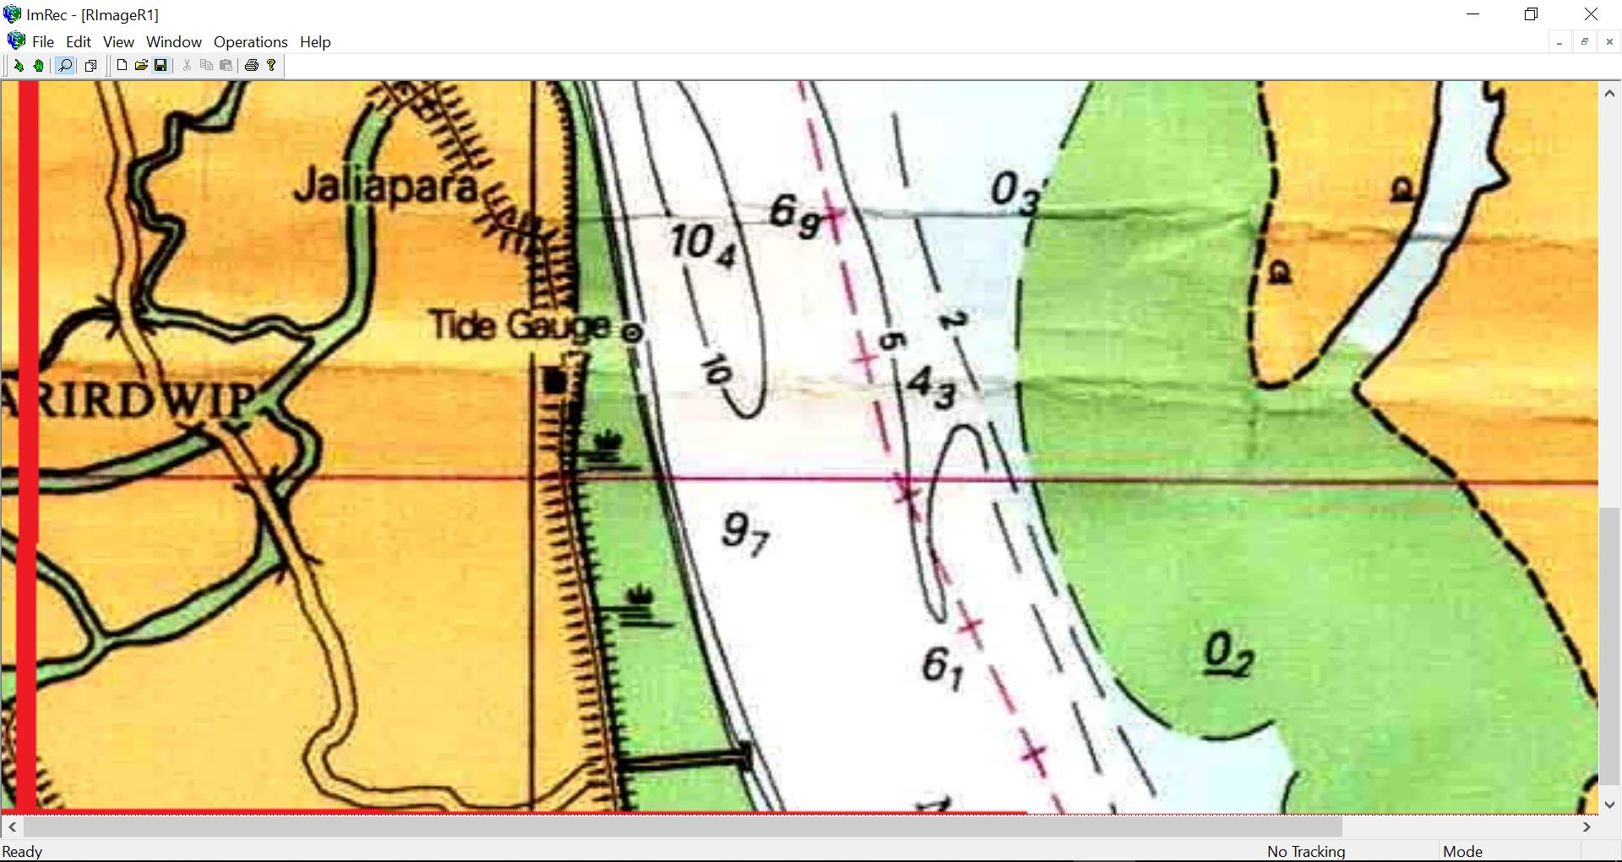
Up-down scrolling and horizontal scrolling can be a useful tool for moving through the image window
Scroll Bar

Slide 61
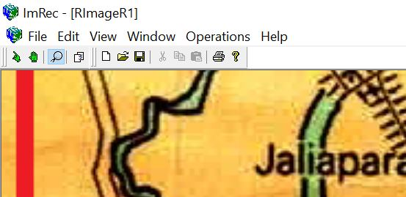
After adding GCP, from the menu bar, navigate to the Operations > Rectification of 2nd. Order

Slide 62
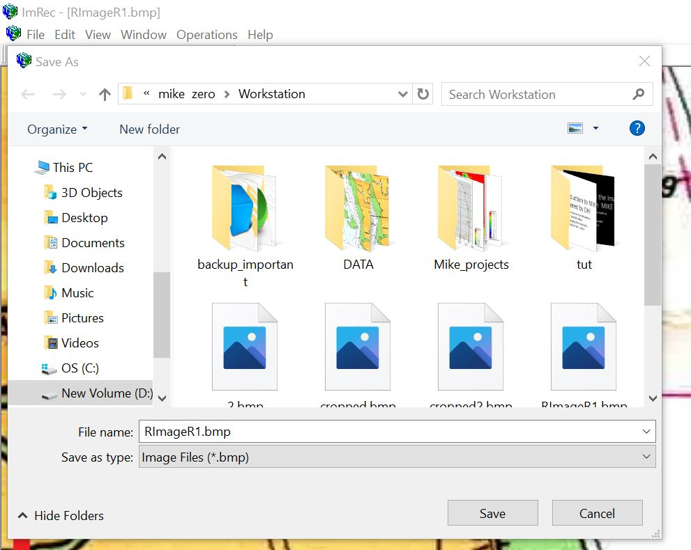
Than save the file in a folder through navigating from the menu bar:
File Save As…

Slide 63
The End
Thank You

